Slide 1
Unsupervised Learning: Dimensionality Reduction (PCA and other methods)
CS771: Introduction to Machine Learning
Piyush Rai

Slide 2
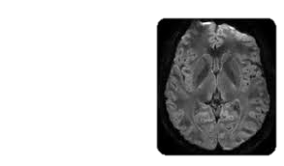
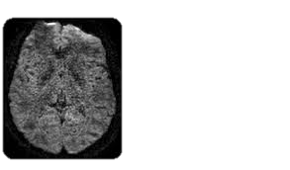
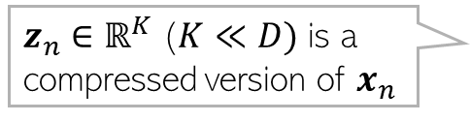
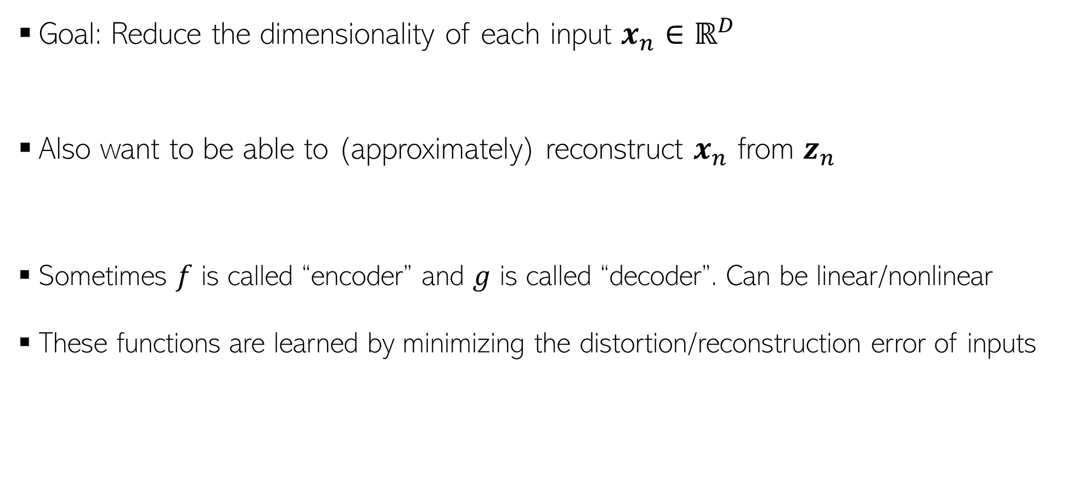
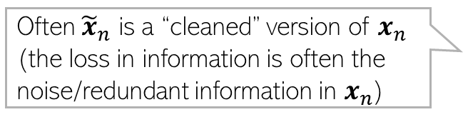

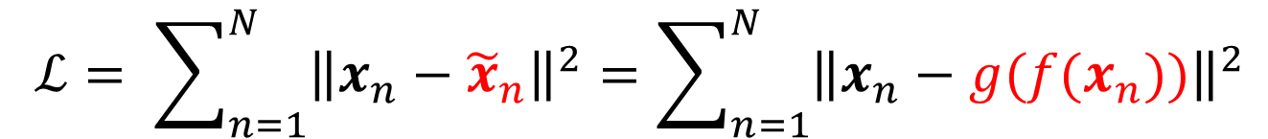


Dimensionality Reduction
$$x_{n}$$
$${\tilde{x}}_{n}$$
Goal: Reduce the dimensionality of each input $x_{n}∈ℝ^{D}$
Also want to be able to (approximately) reconstruct $x_{n}$ from $z_{n}$
Sometimes $f$ is called “encoder” and $g$ is called “decoder”. Can be linear/nonlinear
These functions are learned by minimizing the distortion/reconstruction error of inputs
$z_{n}∈ℝ^{K}$ ($K≪D)$ is a compressed version of $x_{n}$
$$z_{n}=f(x_{n})$$
Often ${\tilde{x}}_{n}$ is a “cleaned” version of $x_{n}$ (the loss in information is often the noise/redundant information in $x_{n}$)
$${\tilde{x}}_{n}=g\left(z_{n}\right)=g(f\left(x_{n}\right))≈x_{n}$$
$$ℒ= \sum_{n=1}^{N}{{\left\|x_{n}−{\tilde{x}}_{n}\right\|}^{2}}=\sum_{n=1}^{N}{{\left\|x_{n}−g(f(x_{n}))\right\|}^{2}}$$
Image source: Manjon et al (2013): Diffusion Weighted Image Denoising using overcomplete Local PCA

Slide 3

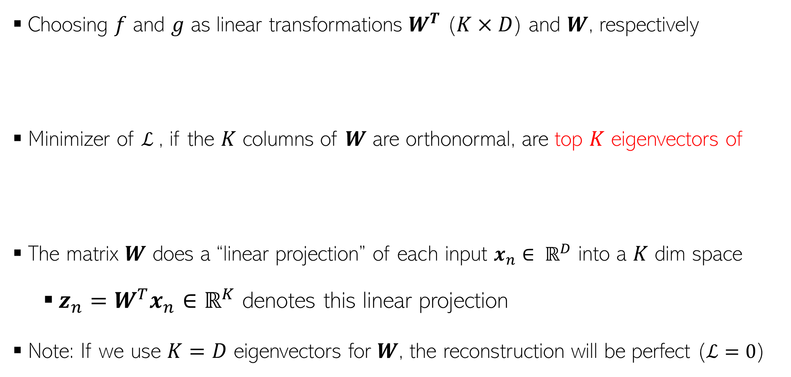
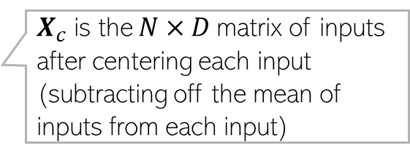

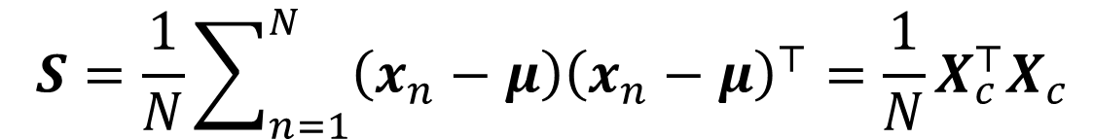
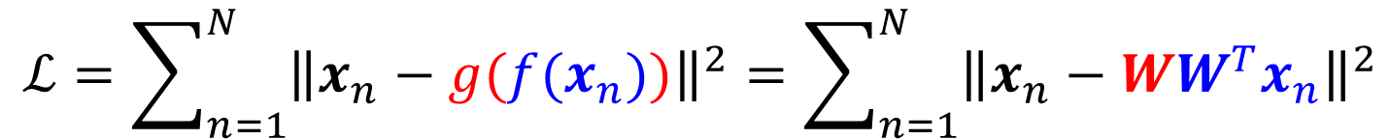

Dimensionality Reduction
Choosing $f$ and $g$ as linear transformations $W^{T}$ ($K×D$) and $W$, respectively
Minimizer of $ℒ$, if the $K$ columns of $W$ are orthonormal, are top $K$ eigenvectors of
The matrix $W$ does a “linear projection” of each input $x_{n}∈ ℝ^{D}$ into a $K$ dim space
$z_{n}=W^{T}x_{n}∈ℝ^{K}$ denotes this linear projection
Note: If we use $K=D$ eigenvectors for $W$, the reconstruction will be perfect ($ℒ=0$)
$$z_{n}$$
$${{\tilde{x}}_{n}=Wz}_{n}$$
$$ℒ=\sum_{n=1}^{N}{{\left\|x_{n}−g({f(x}_{n}))\right\|}^{2}}=\sum_{n=1}^{N}{{\left\|x_{n}−WW^{T}x_{n}\right\|}^{2}}$$
Principal Component Analysis (PCA). Proof shortly
$D×D$empirical covariance matrix of inputs
$$S=\frac{1}{N}\sum_{n=1}^{N}{\left(x_{n}−μ\right){\left(x_{n}−μ\right)}^{⊤}}=\frac{1}{N}X_{c}^{⊤}X_{c}$$
$X_{c}$ is the $N×D$matrix of inputs after centering each input (subtracting off the mean of inputs from each input)

Slide 4
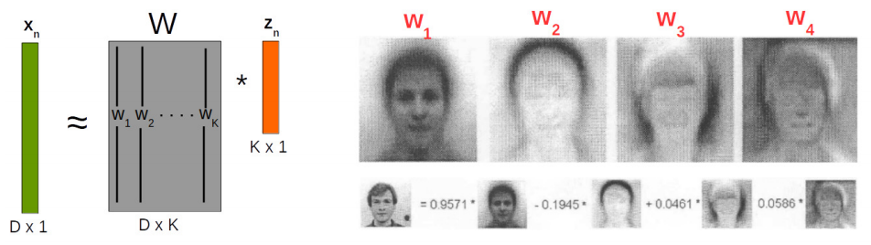
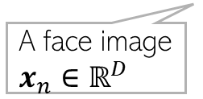



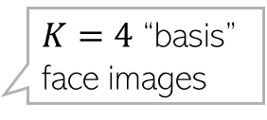

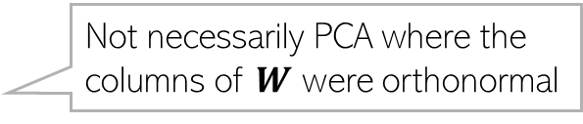




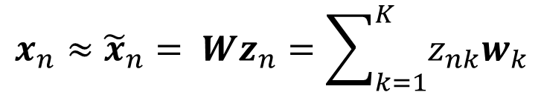


Dimensionality Reduction
Not necessarily PCA where the columns of $W$ were orthonormal
Consider a linear model of the form
Above means that each $x_{n}$ is appox a linear comb of $K$ vectors $w_{1},w_{2},…, w_{K}$
In this example, $z_{n}∈ℝ^{K} (K=4)$ is a low-dim feature rep. for each image $x_{n}∈ℝ^{D}$
$$x_{n}≈{\tilde{x}}_{n}= Wz_{n}=\sum_{k=1}^{K}{z_{nk}w_{k}}$$
$w_{k}$is the $k$-th column of $W$
$K=4$ “basis” face images
Each “basis” image is like a “template” that captures the common properties of face images in the dataset
+
A face image $x_{n}∈ℝ^{D}$
$$z_{n1}$$
$$z_{n2}$$
$$z_{n3}$$
$$z_{n4}$$
$$w_{4}$$
$$w_{1}$$
$$w_{2}$$
$$w_{3}$$

Slide 5
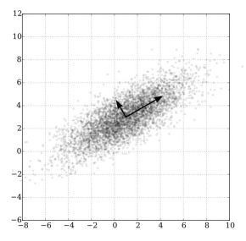
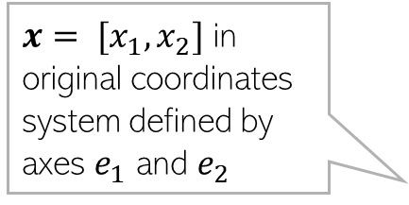

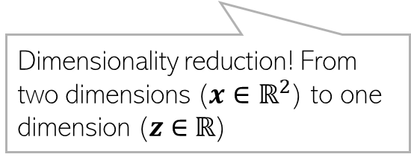





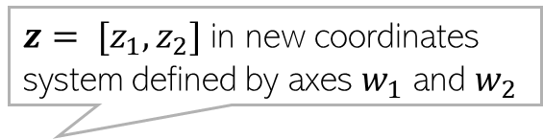
Principal Component Analysis (PCA)
PCA learns a different and more economical coordinate system to represent data
Top eigenvectors of the covariance matrix of inputs give us the large variance directions
$$e_{2}$$
$x= [x_{1},x_{2}]$ in original coordinates system defined by axes $e_{1}$ and $e_{2}$
$z= [z_{1},z_{2}]$ in new coordinates system defined by axes $w_{1}$ and $w_{2}$
With this representation, both coordinates $x_{1}$ and $x_{2}$ have a high variance across all the points so, for any point $x$, we can’t ignore any of these two coordinates otherwise we will lose considerable information about the data
$$w_{1}$$
$$w_{2}$$
Not much variance in the $z_{2}$ coordinates of all the points so we can ignore $z_{2}$ and represent each point using just the first coordinate (i.e., $z=[z_{1}]$) without losing much information about the data
Large variance
Small variance
Dimensionality reduction! From two dimensions ($x∈ℝ^{2}$) to one dimension ($z∈$ $ℝ$)
$$e_{1}$$

Slide 6


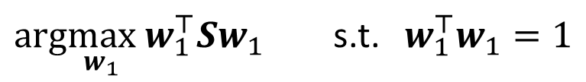



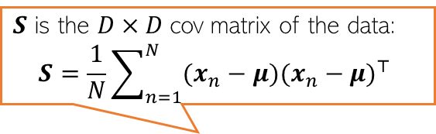

Finding Max. Variance Directions
Consider projecting an input $x_{n}∈ℝ^{D}$along a direction $w_{1}$ $∈ℝ^{D}$
Projection/embedding of $x_{n}$ (red points below) will be $w_{1}^{⊤}x_{n}$ (green pts below)
Want $w_{1}$ such that variance $w_{1}^{⊤}Sw_{1}$ is maximized
Mean of projections of all inputs:
$\frac{1}{N}\sum_{n=1}^{N}{w_{1}^{⊤}x_{n}= }$ $w_{1}^{⊤}(\frac{1}{N}\sum_{n=1}^{N}{x_{n})=w_{1}^{⊤}μ}$
Variance of the projections:
$$\frac{1}{N}\sum_{n=1}^{N}{{{(w}_{1}^{⊤}x_{n}−w_{1}^{⊤}μ)}^{2}=\frac{1}{N}\sum_{n=1}^{N}{{{\{w}_{1}^{⊤}{(x}_{n}−μ)\}}^{2}=}}w_{1}^{⊤}Sw_{1}$$
$$w_{1}$$
$$x_{n}$$
$S$ is the $D×D$cov matrix of the data:
$$S=\frac{1}{N}\sum_{n=1}^{N}{(x_{n}−μ){(x_{n}−μ)}^{⊤} }$$
$$w_{1}^{⊤}x_{n}$$
For already centered data, $μ$= $0$ and $S=\frac{1}{N}\sum_{n=1}^{N}{x_{n}}x_{n}^{⊤}$ = $\frac{1}{N}XX^{⊤}$
$arg\max_{w_{1}}$ $w_{1}^{⊤}Sw_{1}$ s.t. $w_{1}^{⊤}w_{1}=1$
Need this constraint otherwise the objective’s max will be infinity

Slide 7

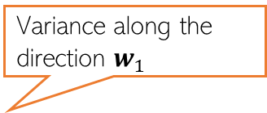
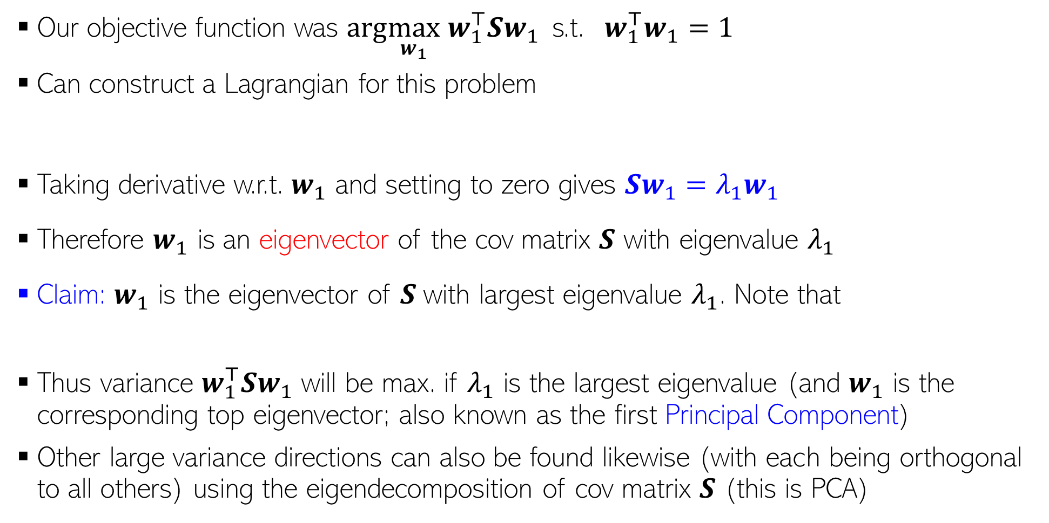

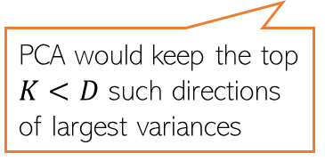
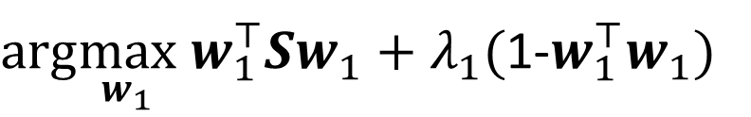
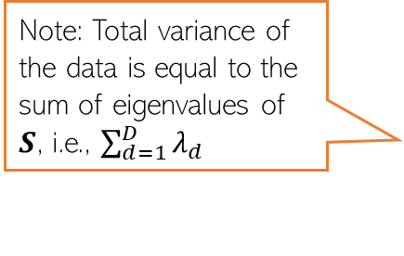
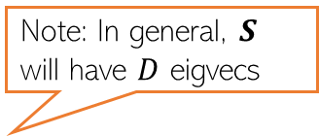
Max. Variance Direction
Variance along the direction $w_{1}$
Note: Total variance of the data is equal to the sum of eigenvalues of $S$, i.e., $\sum_{d=1}^{D}{λ_{d}}$
Our objective function was $arg\max_{w_{1}}$ $w_{1}^{⊤}Sw_{1}$ s.t. $w_{1}^{⊤}w_{1}=1$
Can construct a Lagrangian for this problem
Taking derivative w.r.t. $w_{1}$ and setting to zero gives $Sw_{1}=λ_{1}w_{1}$
Therefore $w_{1}$ is an eigenvector of the cov matrix $S$ with eigenvalue $λ_{1}$
Claim: $w_{1}$ is the eigenvector of $S$with largest eigenvalue $λ_{1}$. Note that
Thus variance $w_{1}^{⊤}Sw_{1}$ will be max. if $λ_{1}$ is the largest eigenvalue (and $w_{1}$ is the corresponding top eigenvector; also known as the first Principal Component)
Other large variance directions can also be found likewise (with each being orthogonal to all others) using the eigendecomposition of cov matrix $S$ (this is PCA)
PCA would keep the top $K<D$ such directions of largest variances
$arg\max_{w_{1}} w_{1}^{⊤}Sw_{1}+λ_{1}($1-$w_{1}^{⊤}w_{1})$
Note: In general, $S$ will have $D$ eigvecs
$w_{1}^{⊤}Sw_{1}=λ_{1}w_{1}^{⊤}w_{1}=λ_{1}$

Slide 8



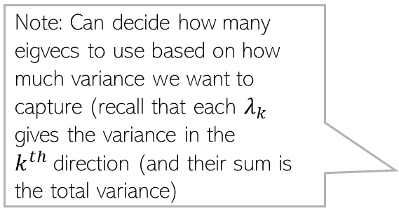
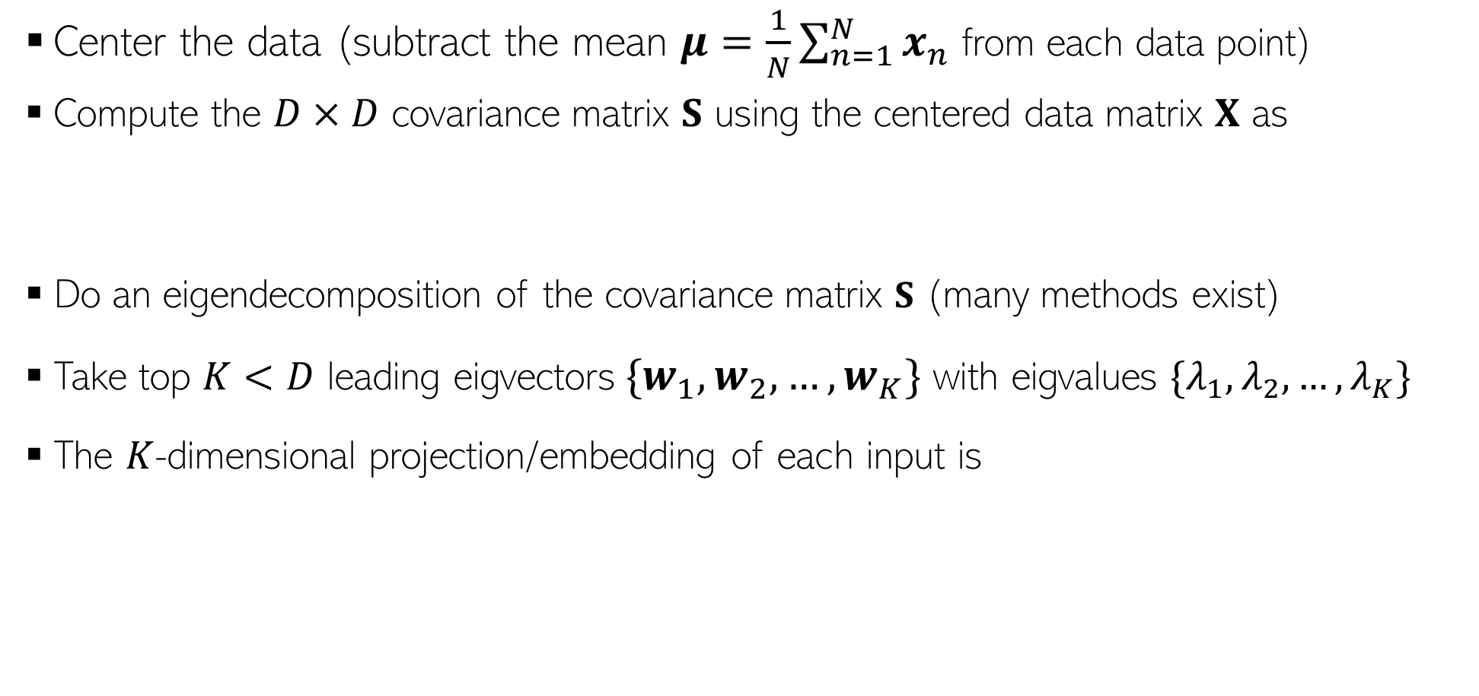
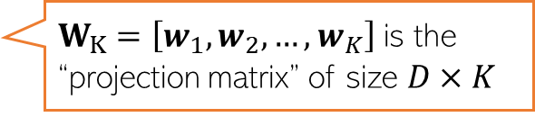
The PCA Algorithm
Center the data (subtract the mean $μ=\frac{1}{N}\sum_{n=1}^{N}{x_{n}}$ from each data point)
Compute the $D×D$ covariance matrix $S$ using the centered data matrix $X$ as
Do an eigendecomposition of the covariance matrix $S$ (many methods exist)
Take top $K<D$ leading eigvectors${\{w}_{1},w_{2},…, w_{K}\}$ with eigvalues $\{λ_{1},λ_{2},…, λ_{K}\}$
The $K$-dimensional projection/embedding of each input is
$$S= \frac{1}{N}X^{⊤}X$$
(Assuming $X$ is arranged as $N×D$)
Note: Can decide how many eigvecs to use based on how much variance we want to capture (recall that each $λ_{k}$ gives the variance in the $k^{th}$direction (and their sum is the total variance)
$$z_{n}≈ W_{K}^{⊤}x_{n}$$
$W_{K}=\left[w_{1},w_{2},…, w_{K}\right]$ is the “projection matrix” of size $D×K$

Slide 9
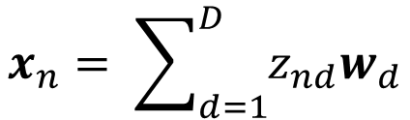
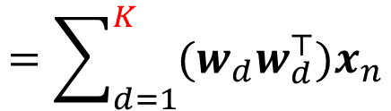
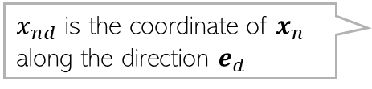

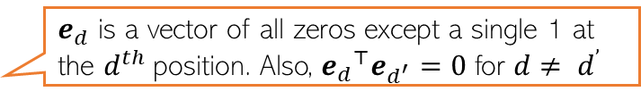
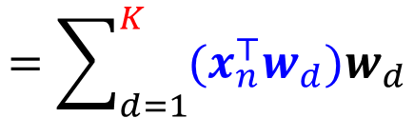

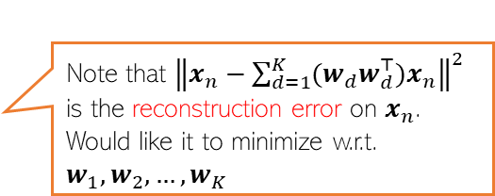
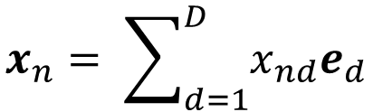
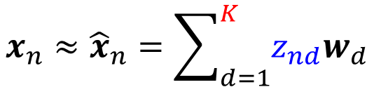
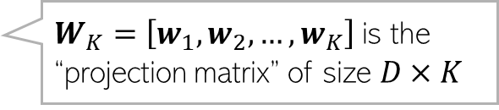
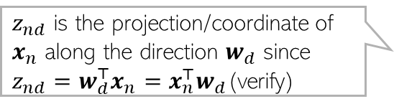


The Reconstruction Error View of PCA
Representing a data point $x_{n}= {[x_{n1},x_{n2},…, x_{nD}] }^{⊤}$ in the standard orthonormal basis $\left\{e_{1},e_{2},…, e_{D}\right\}$
Let’s represent the same data point in a new orthonormal basis $\left\{w_{1},w_{2},…, w_{D}\right\}$
Ignoring directions along which projection $z_{nd}$ is small, we can approximate $x_{n}$ as
Now $x_{n}$ is represented by $K < D$dim. rep. $z_{n} =[z_{n1},z_{n2},…, z_{nK}]$ and
$$x_{n}= \sum_{d=1}^{D}{x_{nd}e_{d}}$$
$e_{d}$ is a vector of all zeros except a single 1 at the $d^{th}$position. Also, ${e_{d}}^{⊤}e_{d^{′}}=0$ for $d≠ d^{’}$
$x_{nd}$ is the coordinate of $x_{n}$ along the direction $e_{d}$
$z_{nd}$ is the projection/coordinate of $x_{n}$ along the direction $w_{d}$ since $z_{nd}=w_{d}^{⊤}x_{n}=x_{n}^{⊤}w_{d}$(verify)
$$x_{n}= \sum_{d=1}^{D}{z_{nd}w_{d}}$$
$z_{n}={[z_{n1},z_{n2},…, z_{nD}] }^{⊤}$denotes the co-ordinates of $x_{n}$ in the new basis
$$x_{n}≈{\hat{x}}_{n}=\sum_{d=1}^{K}{z_{nd}w_{d}}$$
$$=\sum_{d=1}^{K}{{(x}_{n}^{⊤}w_{d})w_{d}}$$
$$=\sum_{d=1}^{K}{{(w_{d}w}_{d}^{⊤})x_{n}}$$
Note that ${\left\|x_{n}−\sum_{d=1}^{K}{{(w_{d}w}_{d}^{⊤})x_{n}}\right\|}^{2}$ is the reconstruction error on $x_{n}$. Would like it to minimize w.r.t. $w_{1},w_{2},…, w_{K}$
$$z_{n}= W_{K}^{⊤}x_{n}$$
$W_{K}=\left[w_{1},w_{2},…, w_{K}\right]$ is the “projection matrix” of size $D×K$
Also, $x_{n}≈W_{K}z_{n}$

Slide 10






PCA Minimizes Reconstruction Error
We plan to use only $K$ directions $\left[w_{1},w_{2},…, w_{K}\right]$so would like them to be such that the total reconstruction error is minimized
Each optimal $w_{d}$ can be found by solving
Thus minimizing the reconstruction error is equivalent to maximizing variance
The $K$ directions can be found by solving the eigendecomposition of $S$
$$ℒ\left(w_{1},w_{2},…, w_{K}\right)= \sum_{n=1}^{N}{{\left\|x_{n}−{\hat{x}}_{n}\right\|}^{2}=\sum_{n=1}^{N}{{\left\|x_{n}−\sum_{d=1}^{K}{{(w_{d}w}_{d}^{⊤})x_{n}}\right\|}^{2}}}$$
Constant; doesn’t depend on the $w_{d}$’s
Variance along $w_{d}$
$=C− \sum_{d=1}^{K}{w_{d}^{⊤}Sw_{d}}$ (verify)
Subject to $w_{d}^{⊤}w_{d}=1$
$arg\min_{w_{d}}$ $ℒ\left(w_{1},w_{2},…, w_{K}\right)=arg\max_{w_{d}} { w}_{d}^{⊤}Sw_{d}$

Slide 11




Singular Value Decomposition (SVD)
Any matrix $X$ of size $N×D$can be represented as the following decomposition
$U=\left[u_{1},u_{2},…, u_{N}\right]$ is $N×N$ matrix of left singular vectors, each $u_{n}∈ℝ^{N}$
$U$ is also orthonormal ($u_{n}^{⊤}u_{n}=1 ∀n$ and $u_{n}^{⊤}u_{n^{′}}=0 ∀n≠n^{′}$)
$V=\left[v_{1},v_{2},…, v_{N}\right]$ is $D×D$ matrix of right singular vectors, each $v_{d}∈ℝ^{D}$
$V$ is also orthonormal($v_{d}^{⊤}v_{d}=1 ∀d$ and $v_{d}^{⊤}v_{d^{′}}=0 ∀d≠d^{′}$)
$Λ$ is $N × D$with only $min⁡(N, D)$diagonal entries - singular values
Note: If $X$ is symmetric then it is known as eigenvalue decomposition ($U=V$)
$$X=UΛV^{⊤}= \sum_{k=1}^{min\{N,D\}}{λ_{k}u_{k}v_{k}^{⊤}}$$
Diagonal matrix. If $N>D$, last $D−N$ rows are all zeros; if $D>N$, last $D−N$ columns are all zeros

Slide 12



Low-Rank Approximation via SVD
If we just use the top $K<min\{N,D\}$ singular values, we get a rank-$K$ SVD
Above SVD approx. can be shown to minimize the reconstruction error $\left\|X−\hat{X}\right\|$
Fact: SVD gives the best rank-$K$ approximation of a matrix
PCA is done by doing SVD on the covariance matrix $S$ (left and right singular vectors are the same and become eigenvectors, singular values become eigenvalues)
This is a rank-1 matrix

Slide 13
Dimensionality Reduction: Beyond PCA

Slide 14







Dim-Red as Matrix Factorization
If we don’t care about the orthonormality constraints on $W$, then dim-red can also be achieved by solving a matrix factorization problem on the data matrix $X$
Can solve such problems using ALT-OPT
Can impose various constraints on $Z$ and $W$(e.g., sparsity, non-negativity, etc)
D
K
D
$$X$$
$$Z$$
$$W$$
K
N
$$≈$$
N
Matrix containing the low-dim rep of $X$
$$\left\{\hat{Z},\hat{W}\right\}= {argmin}_{Z,W}{\left\|X −ZW\right\|}^{2}$$
If $K < min⁡\{D,N\}$, such a factorization gives a low-rank approximation of the data matrix $X$

Slide 15














Matrix Factorization is a very useful method!
In many problems, we are given co-occurrence data in form of an $N×M$ matrix $X$
Data consists of relationship b/w two sets of entities containing $N$ and $M$ entities
Each entry $X_{ij}$ denotes how many times the pair $(i,j)$ co-occurs, e.g.,
Number of times a document $i$ (total $N$ docs) contains word $j$ of a vocabulary (total $M$ words)
Rating user $i$ gave to item (or movie) $j$ on a shopping (or movie streaming) website
$$M$$
$$K$$
$$M$$
$$K$$
$$W$$
$$×$$
$$N$$
$$Z$$
$$X$$
$$≈$$
$$N$$
In such problems, matrix factorization can be used to learn a $K$-dim feature vector for both set of entities
Even if some entries of $X$are missing, we can still do matrix factorization using the loss defined on the given entries of $X$ and use the learned $Z$ and $W$ to predict any missing entry as $X_{ij}≈z_{i}^{⊤}w_{j}$ (matrix completion)

Slide 16

Supervised Dimensionality Reduction
Maximum variance directions may not be aligned with class separation directions (focusing only on variance/reconstruction error of the inputs $x_{n}$, is not always ideal)
Be careful when using methods like PCA for supervised learning problems
A better option would be to find projection directions such that after projection
Points within the same class are close (low intra-class variance)
Points from different classes are well separated (the class means are far apart)
Direction that preserves class separation
Projecting along this will give a one dimensional embedding of each point with both classes overlapping with each other
Projecting along this will give a one dimensional embedding of each point with both classes still having a good separation
Max variance direction (given by PCA)

Slide 17



Dim. Reduction by Preserving Pairwise Distances
PCA/SVD etc assume we are given points $x_{1}, x_{2},…, x_{N}$as vectors (e.g., in $D$ dim)
Often the data is given in form of distances $d_{ij}$ between $x_{i}$ and $x_{j}$ ($i,j=1,2,…,N$)
Would like to project data such that pairwise distances between points are preserved
Basically, if $d_{ij}$ is large (resp. small), would like $\left\|z_{i}−z_{j}\right\|$ to be large (resp. small)
Multi-dimensional Scaling (MDS) is one such algorithm
Note: If $d_{ij}$ is the Euclidean distance, MDS is equivalent to PCA
$z_{i}$ and $z_{j}$ denote low-dim embeddings/projections of $x_{i}$ and $x_{j}$, respectively

Slide 18


MDS: An Example
Result of applying MDS (with $K = 2$) on pairwise distances between some US cities
Here MDS produces 2D embedding of each city such that geographically close cities are also close in 2D embedding space

Slide 19
Nonlinear Dimensionality Reduction

Slide 20

Beyond Linear Projections
Consider the swiss-roll dataset (points lying close to a manifold)
Linear projection methods (e.g., PCA) can’t capture intrinsic nonlinearities
Maximum variance directions may not be the most interesting ones
Relative positions of points destroyed after the projection

Slide 21

Nonlinear Dimensionality Reduction
We want to a learn nonlinear low-dim projection
Some ways of doing this
Nonlinearize a linear dimensionality reduction method. E.g.:
Cluster data and apply linear PCA within each cluster (mixture of PCA)
Kernel PCA (nonlinear PCA)
Using manifold based methods that intrinsically preserve nonlinear geometry, e.g.,
Locally Linear Embedding (LLE), Isomap
Maximum Variance Unfolding
Laplacian Eigenmap, and others such as SNE/tSNE, etc.
.. or use unsupervised deep learning techniques (later)
Relative positions of points preserved after the projection
Will look at KPCA, LLE, SNE/tSNE

Slide 22











Kernel PCA
Recall PCA: Given $N$ observations $x_{n}∈ℝ^{D}$, $n=1,2,…,N$,
Assume a kernel $k$ with associated $M$ dimensional nonlinear map $φ$
Would like to do it without computing $C$ and the mappings $φ{\left(x_{n}\right)}^{′}s$ since $M$ can be very large (even infinite, e.g., when using an RBF kernel)
Boils down to doing eigendecomposition of the $N×N$kernel matrix $K$ (PRML 12.3)
Can verify that each $v_{i}$ above can be written as a lin-comb of the inputs: $v_{i}=\sum_{n=1}^{N}{a_{in}φ(x_{n})}$
Can show that finding $a_{i}=[a_{i1},a_{i2},…, a_{iN}]$ reduces to solving an eigendecomposition of $K$
Note: Due to req. of centering, we work with a centered kernel matrix
$D$ eigenvectors of $S$
$D× D$cov matrix assuming centered data
$M×M$cov matrix assuming centered data in the kernel-induced feature space
$M$ eigenvectors of $C$
$N×N$matrix of all 1s

Slide 23






Locally Linear Embedding
Several non-lin dim-red algos use this idea
Essentially, neighbourhood preservation, but only local
Basic idea: If two points are local neighbors in the original space then they should be local neighbors in the projected space too
Given $N$ observations $x_{n}∈ℝ^{D}$, $n=1,2,…,N$, LLE is formulated as
For each point $x_{n}∈ℝ^{D}$, LLE learns $z_{n}∈ℝ^{K}$, $n=1,2,…,N$ such that the same neighborhood structure exists in low-dim space too
Basically, if point $x_{i}$ can be reconstructed from its neighbors in the original space, the same weights $W_{ij}$should be able to reconstruct $z_{i}$ in the new space too
Solve this to learn weights $W_{ij}$such that each point $x_{i}$ can be written as a weighted linear combination of its local neighbors in the original feature space
$𝒩(i)$ denotes the local neighbors (a predefined number, say K, of them) of point $x_{i}$
Requires solving an eigenvalue problem
S. T. Roweis and L. K. Saul. Nonlinear dimensionality reduction by locally linear embedding. Science 290 (2000)

Slide 24



SNE and t-SNE
Thus very useful if we want to visualize some high-dim data in two or three dims
Also nonlin. dim-red methods, especially suited for projecting to 2D or 3D
SNE stands for Stochastic Neighbor Embedding (Hinton and Roweis, 2002)
Uses the idea of preserving probabilistically defined neighborhoods
SNE, for each point $x_{i}$, defines the probability of a point $x_{j}$ being its neighbor as
SNE ensures that neighbourhood distributions in both spaces are as close as possible
This is ensured by minimizing their total mismatch (KL divergence) $ℒ=\sum_{i=1}^{N}{\sum_{j=1}^{N}{p_{j|i} log \frac{p_{j|i}}{q_{j|i}}}}$
t-SNE (van der Maaten and Hinton, 2008) offers a couple of improvements to SNE
Learns $z_{i}$’s by minimizing symmetric KL divergence
Uses Student-t distribution instead of Gaussian for defining $q_{j|i}$
Neighbor probability in the original space
Neighbor probability in the projected/embedding space

Slide 25

SNE and t-SNE
Especially useful for visualizing data by projecting into 2D or 3D
Result of visualizing MNIST digits data in 2D (Figure from van der Maaten and Hinton, 2008)

Slide 26



Word Embeddings: Dim-Reduction for Words
Or sentences, paragraphs, documents, etc which are basically a set of words
Feature representation/embeddings of words are very useful in many applications
Naively we can a one-hot vector of size $V$ for each word (where $V$ is the vocab size)
One-hot representation of a word has two main issues
Very high dimensionality ($V$) for each word
One-hot vector does not capture word semantics (any pair of words will have zero similarity)
Desirable: Learning low-dim word embeddings that capture the meaning/semantics
We want embedding of each word $n$ to be low-dimensional vector $e_{n}∈ℝ^{K}$
If two words $n$ and $n’$ are semantically similar (dissimilar), we want $e_{n}$ and $e_{n^{′}}$ to be close (far)
Many methods to learn word embeddings (e.g., Glove and Word2Vec)
1 only at the $n$-th location
Word $n$ of the vocabulary
0 | 0 | 0 | 0 | 0 | 0
0 | 1
0 | 0 | 0 | 0

Slide 27










GloVe
GloVe (Global Vectors for Word Representation) is a linear word embedding method
Based on matrix factorization of a word-context co-occurrence matrix
In GloVe, the context consists of words that co-occur within a specified context window around a target word in a large text corpus.
Embedding size
Contexts
Row $n$ ($e_{n}$)denotes the embedding of word $n$
Contexts
Entry $X_{nj}$ denotes number of times a word $n$ appears in a context $i$
$$C$$
$$×$$
$$≈$$
$$E$$
Words
$$X$$
Words
$${\left\|X −EC\right\|}^{2}=\sum_{n,i}{{\left(X_{ni}−e_{n}^{⊤}c_{i}\right)}^{2}}$$
Column $i$($c_{i}$)denotes the embedding of context $i$
Given $X$, minimize this distortion w.r.t. $E$ and $C$ (e.g., using SVD of $X$)
Skipping a few other details such as pre-processing of the data (refer to the paper if interested)
GloVe: Global Vectors for Word Representation (Pennington et al, 2014)

Slide 28




Word2Vec
A deep neural network based nonlinear word embedding method
Usually learned using one of the following two objectives
Skip-gram
Continuous bag of words (CBOW)
Skip-gram: Probability of a context $i$ occurring around a word $n$
CBOW: Probability of word $n$ occurring given a context window, e.g., $k$ previous and $k$ next words
Conditional probability which can be estimated from training data
$$p\left(i | n\right)= \frac{exp(c_{i}^{⊤}e_{n})}{\sum_{i}{exp(c_{i}^{⊤}e_{n})}}$$
Embeddings are learned by optimizing a neural network based loss function which makes the difference b/w LHS and RHS small
Conditional probability which can be estimated from training data
Sum/average of the embeddings of the context window for word $n$
$$p\left(n | n−k:n+k\right)= \frac{exp(e_{n}^{⊤}c_{n})}{\sum_{n}{exp(e_{n}^{⊤}c_{n})}}$$
Embeddings are learned by optimizing a neural network based loss function which makes the difference b/w LHS and RHS small
Efficient Estimation of Word Representations in Vector Space (Mikolov et al, 2013)

Slide 29

Dimensionality Reduction: Out-of-sample Embedding
Some dim-red methods can only compute the embedding of the training data
Given $N$ training samples $\{x_{1},x_{2},…, x_{N}\}$ they will give their embedding $\{z_{1},z_{2},…, z_{N}\}$
However, given a new point $x_{∗}$ (not in the training samples), they can’t produce its embedding $z_{∗}$ easily
Thus no easy way of getting “out-of-sample” embedding
Some of the nonlinear dim-red methods like LLE, SNE, KPCA, etc have this limitation
Reason: They don’t learn an explicit encoder and directly optimize for ${\left\{z_{n}\right\}}_{n=1}^{N}$ given ${\left\{x_{n}\right\}}_{n=1}^{N}$
To get “out-of-sample” embeddings, these methods require some modifications*
But many other methods do explicitly learn a mapping $z=f(x)$ in form of an “encoder” $f$ that can give $z_{∗}$ for any new $x_{∗}$ as well (such methods are more useful)
For PCA, the $D×K$ projection matrix $W_{K}$ is this encoder function and $z_{∗}=W_{K}^{⊤}x_{∗}$
Neural network based autoencoders can also do this (will see them later)
*Out-of-Sample Extensions for LLE, Isomap, MDS, Eigenmaps, and Spectral Clustering (Bengio et al, 2003)

